Slide 1

Analysis on Refrigerators of Various Brands from Flipkart

Slide 2
About me
Background ? (B-tech or M-tech)
I have graduated with a B-Tech degree in Electrical and Electronics Engineering in 2024.
Why you want to learn Data Science
As a 2024 B-Tech graduate, I want to learn data science because of my passion for analyzing data to uncover meaningful insights that can drive impactful decisions.
Additionally, data science offers extensive opportunities for growth and impact, making it an ideal field for me to start my career as a fresher.
Any work experience
As a recent B-Tech graduate I do not have any prior work experience.
Share your linkedin and github profile urls
LinkedIn:- https://www.linkedin.com/in/rohith-kumar-99720b280
GitHub:- https://github.com/Rohithmasineni

Slide 3
Business Problem
The problem statement is focused on analyzing the prices of various brands of refrigerators available on Flipkart through web scraping.
By gathering and examining this data, the goal is to gain insights into the pricing trends, features, and other relevant factors associated with these products on the e-commerce platform.

Slide 4
Use Cases
1. Consumer Insights
Understand customer preferences by analyzing ratings, reviews, and price ranges to determine popular brands and sought-after features in refrigerators.
2. Market Research
Compare brands and models to identify market trends, pricing patterns, and opportunities for introducing innovative features or products.
3. Business Strategy
Enable brands to make data-driven decisions for competitive positioning, targeted marketing, and inventory management.
4. E-commerce Enhancement
Optimize the online shopping experience by improving product recommendations, refining filters, and addressing customer needs more effectively.
5. Customer Support
Identify and resolve common issues from reviews and feedback, enhancing service quality and customer satisfaction for specific refrigerator models or brands.

Slide 5
Objective of the Project
The objective of this project is to:
Extract the various brands of refrigerators data using Web Scraping techniques from the Flipkart website.
Next step involves in cleaning and preprocessing the raw data to ensure accuracy and consistency.
Data Analysis & Visualisation:
This project involves analyzing refrigerator prices on Flipkart, focusing on trends based on brand, capacity, energy efficiency, and features.
Key insights, such as correlations between price and brand reputation or energy ratings, will be highlighted. Visualizations like charts and graphs will communicate trends and findings clearly.

Slide 6
Web Scraping Details
Website Scrapped:
Flipkart was the primary source of data for this project. The URLs for various refrigerator brands and search results were targeted.
Link:- https://www.flipkart.com/
Process followed:
Planning the Data to Scrape:
Identified key attributes of refrigerators to extract, including:
Brand Name, Capacity, Door type, Energy Efficiency Rating, Compressor type, Cooling Type, Prices and Offers
2) Inspecting the Web Page:
Used Google Chrome DevTools (Inspect Element) to:
Locate HTML tags and classes for specific data points.
Understand the pagination structure for scraping multiple pages.

Slide 7
3) Setting up the Environment:
Installed required python libraries such as:
Pandas, BeautifulSoup, requests, NumPy, re
4) Fetching the HTML:
Used the requests library to fetch the HTML content of Flipkart pages
url = "https://www.flipkart.com/search?q=refrigerators"
response = requests.get(url)
soup = BeautifulSoup(response.content, 'html.parser’)
5) Parsing the HTML:
Used BeautifulSoup to parse and extract the required data
6) Handling Pagination:
Iterated over multiple pages using the pagination URLs to scrape data for all relevant refrigerators

Slide 8
7) Data Cleaning :
Removed unnecessary characters (e.g., Currency symbols)
Converted text to appropriate data types (e.g., prices to integers, ratings to floats)
8) Data Storage :
Stored the cleaned data in a Pandas Data Frame for analysis
9) Data Visualization :
Used libraries like Matplotlib and Seaborn to create visualizations for :
Distribution of refrigerator prices.
Comparison of ratings across brands.
Analysis of popular storage capacities.

Slide 9
Summary of the Data
Dataset Overview: The dataset contains 576 rows and 10 columns, representing various attributes of refrigerators listed on Flipkart.
Column Types: The dataset includes a mix of categorical (object type) and numerical data (int64 and float64), with key columns like Brand_Name, Door_Type, and Energy_Efficiency_Rating.
Price and Discount: The dataset provides pricing details (Actual_price and Selling_price) along with Offer_percentage to analyze discounts and affordability trends.
Performance Metrics: The Rating column captures customer feedback as a numerical value (float64), allowing insights into customer satisfaction.
Feature Details: Columns such as Capacity_in_Liters, Compressor_type, and Cooling_Type provide technical specifications for evaluating product features.

Slide 10
Exploratory Data Analysis
Data Cleaning Steps : To prepare raw data for analysis by fixing errors and ensuring consistency
Data cleaning involves imputing missing values, fixing data types of each columns etc…
We have had 3 columns with null values. They are: Energy_Efficiency_Rating, Compressor_Type & Actual_Price.
These missing values are filled by researching about the factors that are effecting these features.
For example: The factors that effect Energy_Efficiency_Rating are: No.of doors, and price
Data Manipulation Steps : To transform and prepare data for specific analysis tasks
With the help of regular expressions new columns are extracted from the raw dataset.
As we want only relevant data for analysis, the first column is extracted as brand name, capacity in liters, door type, and energy efficiency rating.
And from the features column, few more columns like compressor type, and cooling type are extracted.

Slide 11
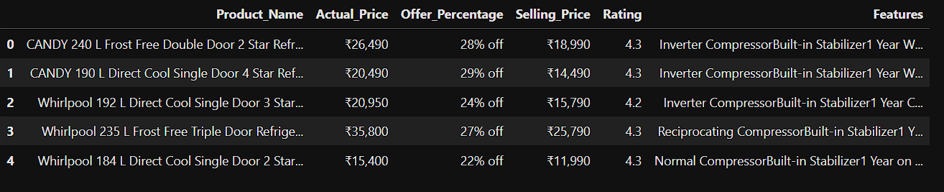
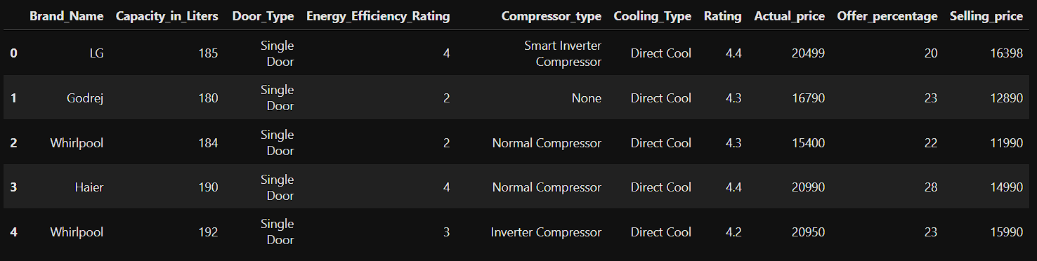
Before Data Manipulation
After Data Manipulation and Cleaning

Slide 12
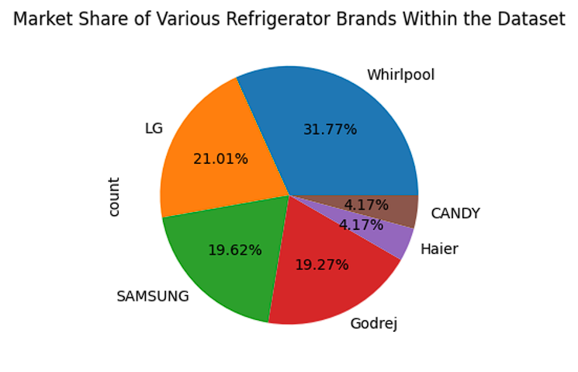
Univariate Analysis Steps
# Market Share of Various Refrigerator Brands Within the Dataset
This distribution highlights that Whirlpool, LG, and Samsung are the top three refrigerator brands, making up most of the market in the dataset.
Haier and CANDY have the smallest presence, showing they are less popular compared to the other brands.

Slide 13
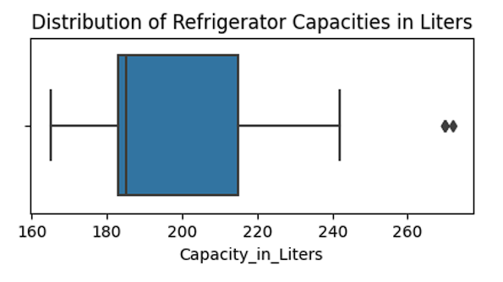
# Distribution of Refrigerator Capacities in Liters
The graph is box plot, illustrating the distribution of refrigerator capacities in liters:
Median: The line inside the box represents the median, which is around 185 liters
Interquartile Range(IQR):
The box itself spans the interquartile range, which is the range between the 25th percentile(Q1) and the 75th percentile(Q3).
This indicates that 50% of refrigerators have capacities falling within this range.

Slide 14
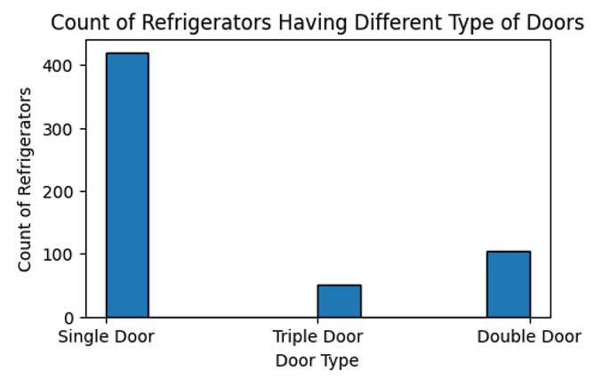
# Count of Refrigerators Having Different Type of Doors
The below graph is a Histogram which gives the information about the Count of Refrigerators Having Different Type of Doors
Here, we can see clearly that the majority of refrigerators are of Single Door type (i.e, around 420)
Double Door type (i.e, around 100) and Triple Door type (i.e, around 50)

Slide 15
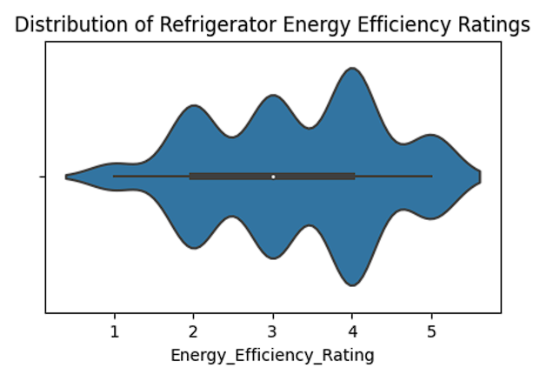
# Distribution of Refrigerator Energy Efficiency Ratings
It shows the distribution of Energy Efficiency Ratings for refrigerators.
The wider section of violin indicates the higher density of data points, while thinner sections of represent lower densities.
The white dot in the middle of violin plot represents the median value, and thick black line extends to the first and third quartiles

Slide 16
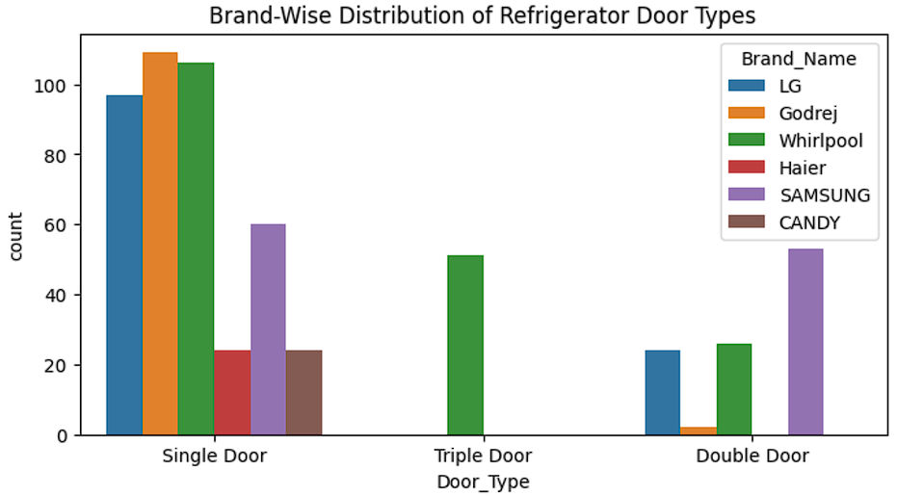
Bivariate Analysis Steps
# Brand-Wise Distribution of Refrigerator Door Types
The count plot illustrates the distribution of different refrigerator door types across various brands. Here is an interpretation of the plot:
The x-axis represents different types of refrigerator doors (Single Door, Double Door, and Triple Door).
The y-axis shows the count of refrigerators with each door type.

Slide 17
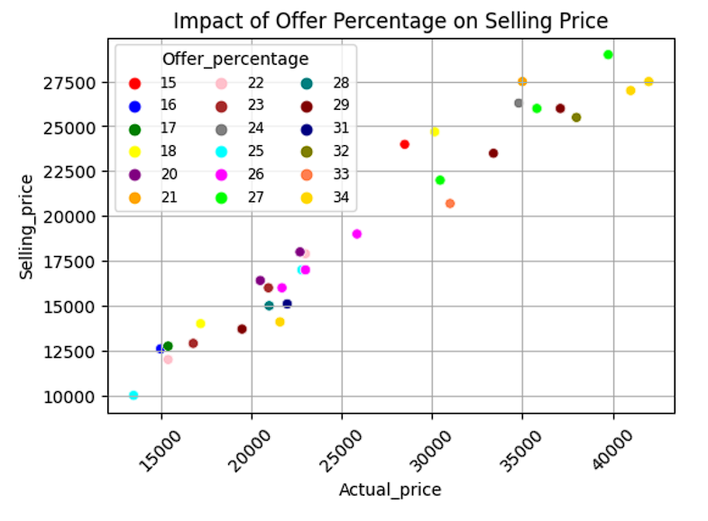
# Impact of Offer Percentage on Selling Price
The scatter plot demonstrates the relationship between certain refrigerator's actual price, selling price, and the offer percentage.
As the actual price increases, the selling price tends to decrease. This suggests that higher offer percentages are applied to products with higher actual prices, resulting in a lower final selling price.

Slide 18
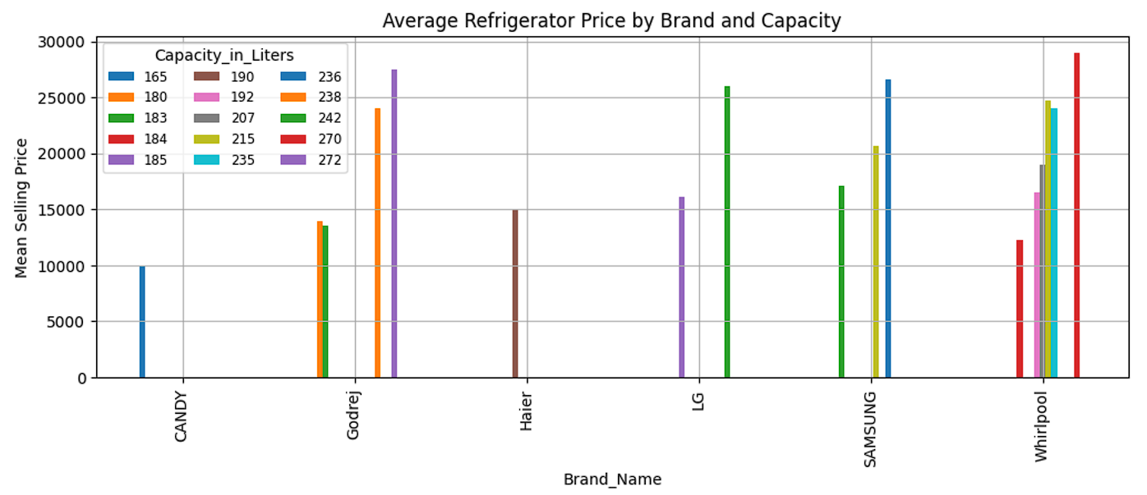
# Average Refrigerator Price by Brand and Capacity
This visualisation effectively highlights how refrigerator prices vary by brand and capacity, offering insights for consumers or stakeholders interested in pricing strategies.
The price generally increases with the refrigerator's capacity.
Whirlpool, LG, SAMSUNG, and Godrej brands dominate the higher price ranges for larger capacities, making them premium options.
CANDY and Haier appears to cater to the budget segment.

Slide 19
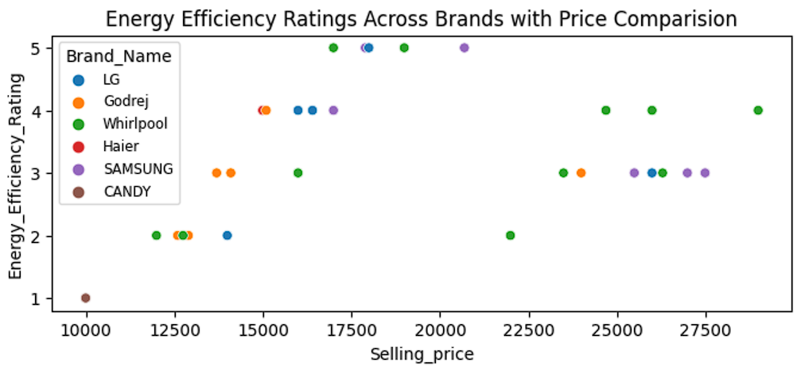
# Energy Efficiency Ratings Across Brands with Price Comparision
The scatter plot shows the 'Energy Efficiency Ratings Across Brands with Price Comparison. It compares different brands based on their Energy Efficiency Ratings and their selling price.
Godrej and Haier brands might be focused on offering products within a friendly budget.
The scatter plot suggests that energy efficiency rating and price may have some correlation, where higher ratings might lead to a higher price, though this varies across the brands

Slide 20
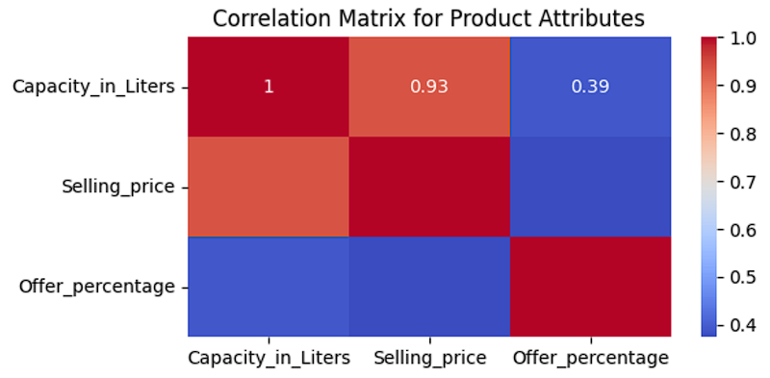
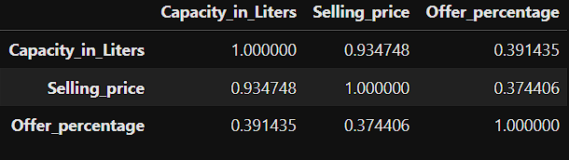
# Correlation Matrix for Product Attributes
The heatmap and the correlation matrix provide insights into the relationships between the attributes of products: Capacity in Liters, Selling Price, and Offer Percentage.
Capacity in Liters vs. Selling Price: Strong positive correlation (0.93), indicating larger refrigerators tend to have higher prices.
Capacity in Liters vs. Offer Percentage: Weak positive correlation (0.39), suggesting slight increases in offers for larger capacities.
Selling Price vs. Offer Percentage: Weak positive correlation (0.37), showing higher-priced refrigerators may have marginally better offers.
Correlation Matrix

Slide 21
Conclusion
This project involved extracting, cleaning, and analyzing data for refrigerators from Flipkart to uncover valuable market insights. Web scraping enabled access to real-time data, capturing details like brand, price, capacity, energy ratings, and customer feedback. Rigorous cleaning, including handling null values, fixing data types, and deriving new columns, ensured a well-structured dataset for analysis. Exploratory Data Analysis (EDA) revealed trends in pricing, brand preferences, energy efficiency, and customer ratings, visualized through univariate, bivariate, and multivariate analyses. The project highlighted how data science techniques can benefit both customers and businesses while emphasizing the importance of ethical web scraping.

Slide 22
Challenges working on Web Scraping – Data Analysis Project
Inconsistent HTML Structures During Scraping:
Extracting data from the Flipkart website was challenging due to inconsistent HTML structures across product pages. For instance, the class names for product details varied across items.
Handling Null Values and Fixing Data Types:
Columns like Compressor Type, Ratings, and Energy Efficiency Ratings required imputation, which could not be done using statistical methods but instead needed general research on refrigerators and their features. Fixing data types for these columns was also quite challenging.
Identifying Relationships Between Columns:
Finding meaningful relationships between columns like price, capacity, and offers was difficult as it was the first project of this kind. It involved experimenting with various analyses and visualizations to uncover patterns.

Slide 23
Experience
Despite these challenges, I gained hands-on experience in Exploratory Data Analysis (EDA), which helped me understand how to uncover meaningful insights and identify relationships between variables.
This project highlighted the importance of structuring and cleaning data to ensure accuracy and consistency, improving my data preprocessing and handling skills significantly.
Overall, the challenges strengthened my problem-solving abilities and gave me practical exposure to the complete data analysis workflow.

Slide 24


Slide 25

THANK YOU

